Slide 1
ANALYZING LIVERPOOL’S ATTACK
DATA ANALYTICS COMPETITION - 2020 SOUNDERS FC SOCCER ANALYTICS CONFERENCE
For the competition I used the data (19 Liverpool Goals) provided by @last_row and some of the data science and data visualizations from Laurie Shaw provided by the Friends of Tracking initiative.
Philipp Hollenhorst

Slide 2
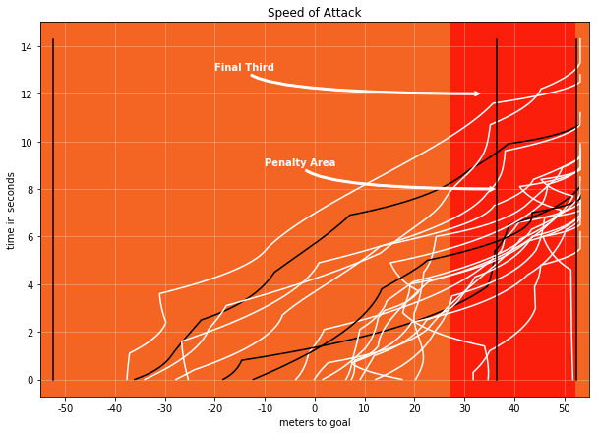
Speed of Attack
This graph shows the the distance from the ball to the goal on the x-axis and the time in seconds on the y-axis. Each line represents the movement of the ball from start of the sequence to end of the sequence.
The graph outlines that Liverpool progresses the ball forward in a very fast manner.
The graph emphasizes vertical play because there is barely any movements of the ball backwards (unless in the box or final third)
The three black lines are analyzed on the following slide.
Counter Attacks and Long Balls

Slide 3
Speed of Attack
Overview of time, distance travelled by the ball and ball progression of the 19 Liverpool goals. Three examples of fast ball progression ( black lines in graph on prior slide)
 | Average | Porto - Liverpool | Bayern - Liverpool | Liverpool - Man City
Time in seconds (Start of sequence - Goal) | 9.11 | 11 | 8.2 | 8.3
Distance travelled by the ball in m (Start of sequence - Goal) | 59.57 | 90.58 | 73.4 | 70.9
Ball progression per second in m (Start of sequence - Goal) | 6.47 | 8.23 | 8.95 | 8.55
Counter Attacks and Long Balls

Slide 4
High Risk → High Reward
Liverpool plays high risk passes with a lower success probability in their build up to the goals. They know that if the pass will be successful there is likely to be a higher reward → goal or shot.
This works well for Liverpool for the following reasons:
Quality of the passer
Quality of the receiver (e.g. speed of recipient, anticipation of the pass)
Liverpool’s Counterpress to win the ball back if pass is unsuccessful

Slide 5
High Risk → High Reward
5 Examples of High Risk → High Reward Passes
Game | pass success probability | passtype
Liverpool- Bournemouth | 0.002 | 2nd Assist
Bayern- Liverpool | 0.05 | Assist
Bournemouth - Liverpool | 0.05 | Assist
Liverpool - ManCity | 0.23 | Assist
Liverpool - Everton | 0.26 | Assist

Slide 6
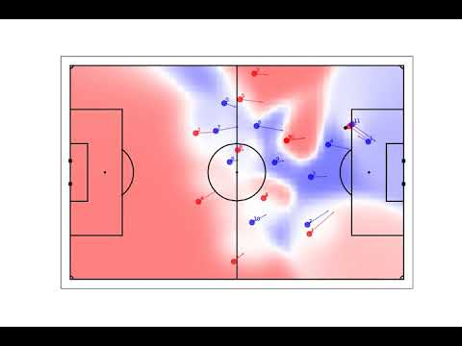
High Risk → High Reward
Example Bayern - Liverpool
Long pass from van Dijk behind the Bayern’s last defensive line. This is a very difficult pass with a low chance of completion because that area is controlled by Bayern Munich. Due to perfect execution of the pass and timing of the run it is completed and Mane converts the chance.

Slide 7
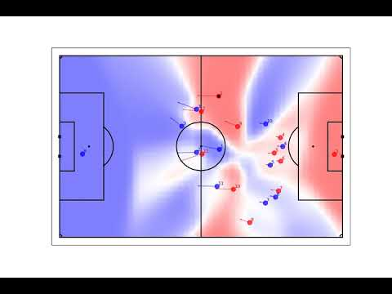
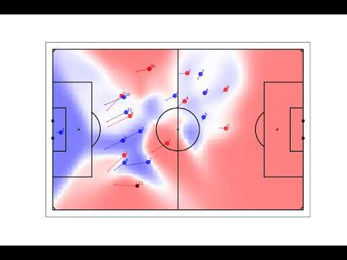
Pitch Control
Here are a two examples where Liverpool controls the dangerous areas of the field in their sequence to score a goal. Both of these examples also underline the speed of attack and high risk passing.
Porto Liverpool: Quick transition from Liverpool after they win the ball. Liverpool controls dangerous areas of the pitch. Successful high risk through ball to set up the goal.
Liverpool Man City:
After escaping pressure and switching the play to the other side, Robertson carries the ball forward. Liverpool’s front three sprint to get into the box and control areas inside the box.

Slide 8
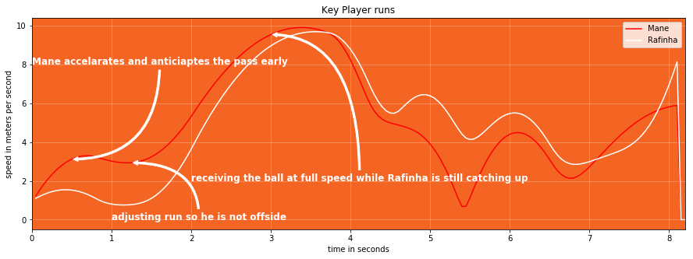
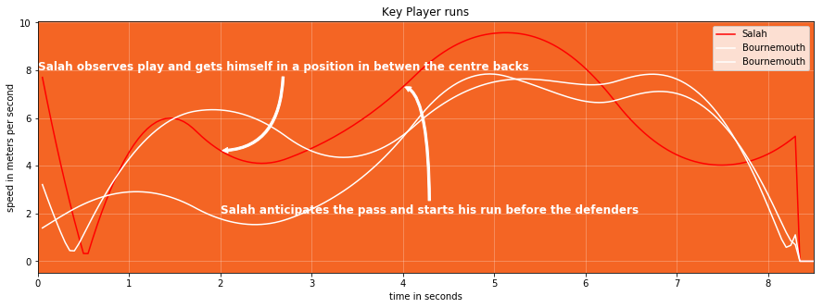
Timing + Anticipation + Speed
With a combination of timing, anticipation and speed Liverpool's’ player’s time their runs perfectly. Before the opponent knows what’s happening they are already on their way. The graph shows speed in meters per second on the y-axis of a player while the x-axis shows the time in seconds of a sequence.
Example Bayern-Liverpool - As seen on an earlier slide: Mane anticipates the pass and starts his run in behind early, adjusts to stay onside and then uses his speed to receive the pass while Rafinha is trying to catch up.
Example Bournemouth-Liverpool - Here Salah observes how the play develops and positions himself well in between the two centre backs. He anticipates the pass and starts his run early while the Bournemouth centre backs still watch the ball.

Slide 9
Take-Aways
Key Aspects of Liverpool’s Attack:
High pace attacks → counter attacks , transitions and long balls
high risk vertical passing
Determination to control dangerous areas → sprints to get into good positions
Speed timing and anticipation → runs behind the last defensive line, always “switched on”

